Slide 1


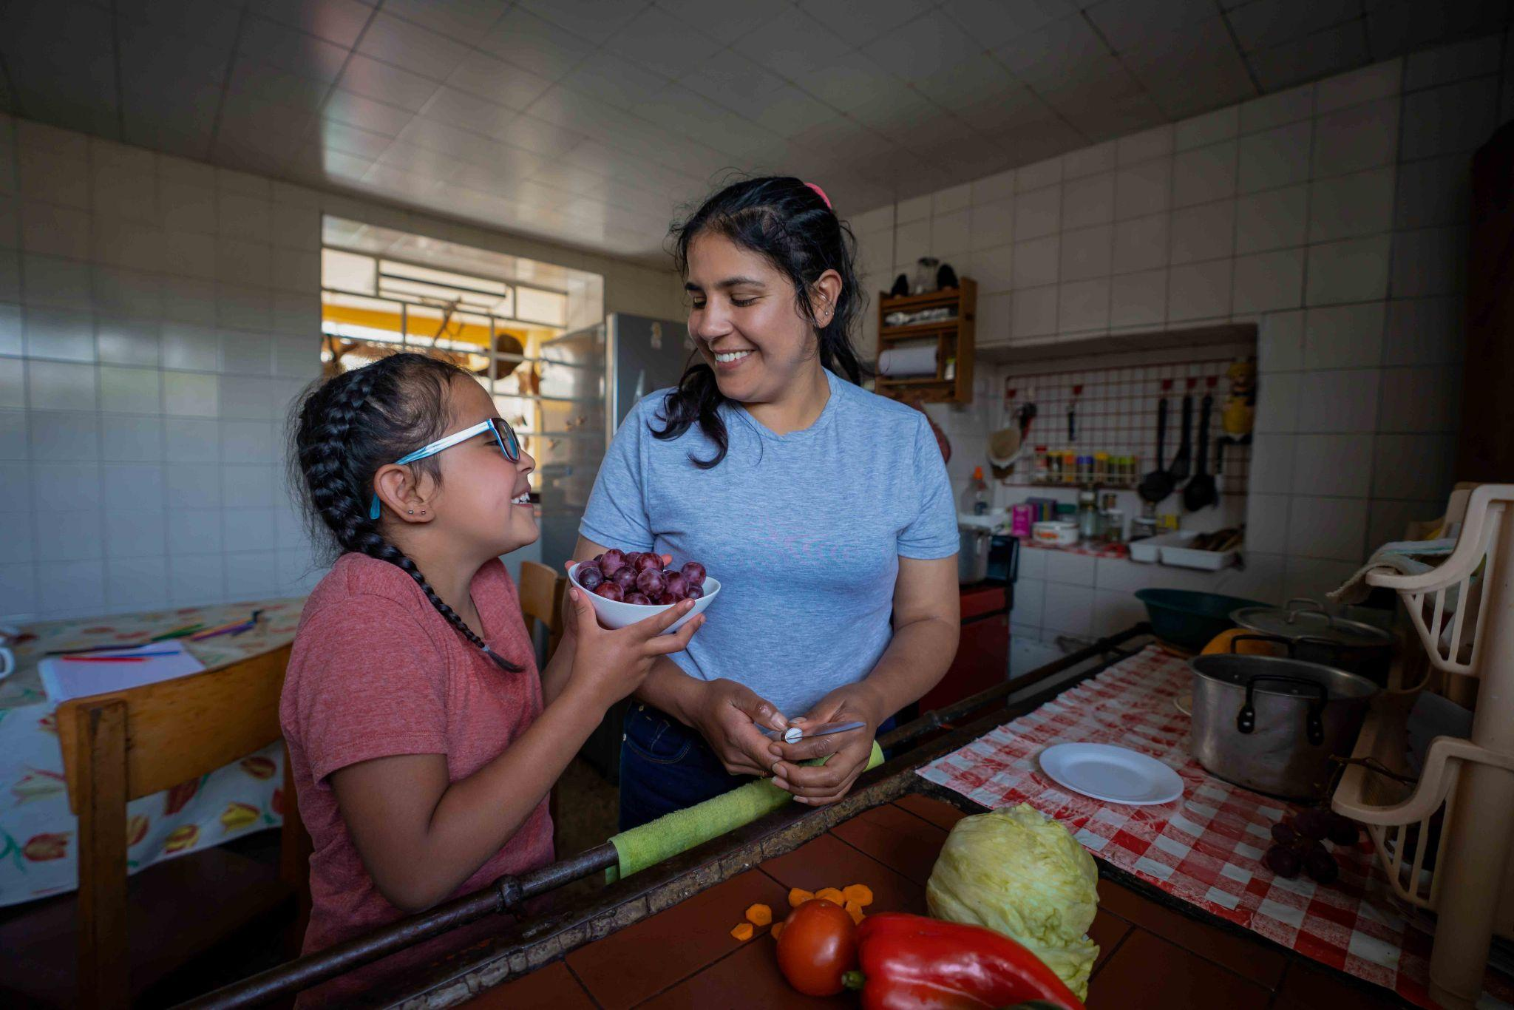


THE STATE OF ALICE IN
THE PACIFIC NORTHWEST
An Overview of Financial Hardship for Struggling Families

Slide 2




TRAINING AGENDA:
ALICE Impossible Choices Scenario Activity
Overview of ALICE Data and Website
Discussion
  How can ALICE data be used in work both professional and volunteer
  What Northwest Gas Associations products or services are relevant and approachable for ALICE families
Q & A
Closing

Slide 3

Who is ALICE ?
®
Asset Limited, Income Constrained, Employed
Notes:
For millions of families in the Pacific Northwest, no matter how hard they work, financial stability grows farther out of reach with each passing day. Hidden in plain sight, these struggling households are ALICE® – Asset Limited, Income Constrained, Employed.
ALICE households bring in income above the Federal Poverty Level, but less than the cost of basics in the counties where they live. While ALICE households have been struggling in the shadows for far too long, the irony is that we all know ALICE. In fact, we’re already talking about ALICE. But many have used terms like “working poor,” “the invisible,” and “the forgotten” to describe ALICE because often we don’t know what other term to use. United For ALICE, a national research organization from New Jersey whose work is backed by more than 300 experts nationwide, has given us a name and a way to quantify this population that we see – and rely on – each and every day.
ALICE is everywhere. ALICE can be a neighbor, a friend, a family member, or a colleague. ALICE workers typically include our child care providers, retail salespeople, cashiers, waiters, delivery drivers, gas station attendants, and caregivers.
Think for a moment about the ALICE workers you’ve encountered just today. Maybe you dropped off your kids at their child care center this morning. Then perhaps you filled your gas tank before you started your work day. Maybe you went to your favorite deli for lunch. Or went out to run an errand at the grocery store. There may even be an Amazon package sitting outside your door right at this very moment.
ALICE workers are the engine that makes our economy – and our daily lives – run smoothly. Yet all this time they’ve been overlooked and undercounted as they live each day priced out of survival and unable to make ends meet in our region.

Slide 4

ALICE Faces Impossible Choices
Notes:
In a constant battle to make ends meet, ALICE families are forced to make impossible choices daily. Pay my heating bill, or buy healthy food for my family? Pay for child care, or work reduced hours to stay home with my child? Buy the medication I need, or pay the rent? Each day brings a new impossible decision, a new weight to lay on the shoulders of these already burdened and stressed families. And to make matters worse, many ALICE families can’t access assistance that’s needed – because often they bring in too much income to qualify.

Slide 5

Notes:
Charlene’s ALICE Story:
Charlene is a single mother who works full time while raising her two young sons. While she works to improve the quality of area child care centers, she struggles to provide for her family. This is her story.

Slide 6
The True Extent of Hardship
(Oregon, Washington, and Idaho)
11%
Households in Poverty
30%
ALICE
Households
41%
Total Households Unable to Afford Basics
Data Source: United For ALICE® (2025). The State of ALICE in OR, WA, & ID.
Notes:
Let’s pull back the curtain on the true extent of hardship in the communities you serve. In Washington and Oregon combined, nearly 530,000 households were living in poverty in 2023. That’s 11% of households. But another 1,383,000+ households - more than twice as many – were ALICE, also struggling to get by.
Combined, more than 1.9 million households – a staggering 40% – fell below the ALICE Threshold, the average income needed to live and work in today’s economy. This is the reality of hardship in our state/county, concealed by outdated measures that have long been considered the standard.

Slide 7
The Demographics of Hardship
Households most likely to struggle financially include:
Black households
Under the age of 25
Single-Female-Headed Households
Notes:
Let’s take a closer look at some ALICE demographics. ALICE households span all ages, genders, races, and ethnicities, living in urban, suburban, and rural communities all around the country – and all across our region. But some groups experience hardship at disproportionate rates because of systemic barriers. For example, in 2023, 61% of Black households in Oregon fell below the ALICE Threshold.
Others that are more likely to struggle financially than their counterparts include:
Under age 25
Single-female-headed households

Slide 8

County Snapshots
Percentage of Struggling Households
OREGON
WASHINGTON
Idaho
Highest: Wheeler and Harney, 59%
Lowest: Deschutes, 32%
Highest: Pacific, 62%
Lowest: Kitsap, 32%
Highest: Madison, 64%
Lowest: Ada, 34%
Notes:
There are also variations in hardship by location. If we look at each state broken out by county, we can see that in 2023, Oregon households were more likely to struggle in Wheeler and Harney Counties – both with 59% of households in hardship…and least likely in Deschutes County, at 32%. For Washington, Pacific County households faced the highest amount of hardship at 62%, where Kitsap County came in the lowest percent of ALICE households.

Slide 9
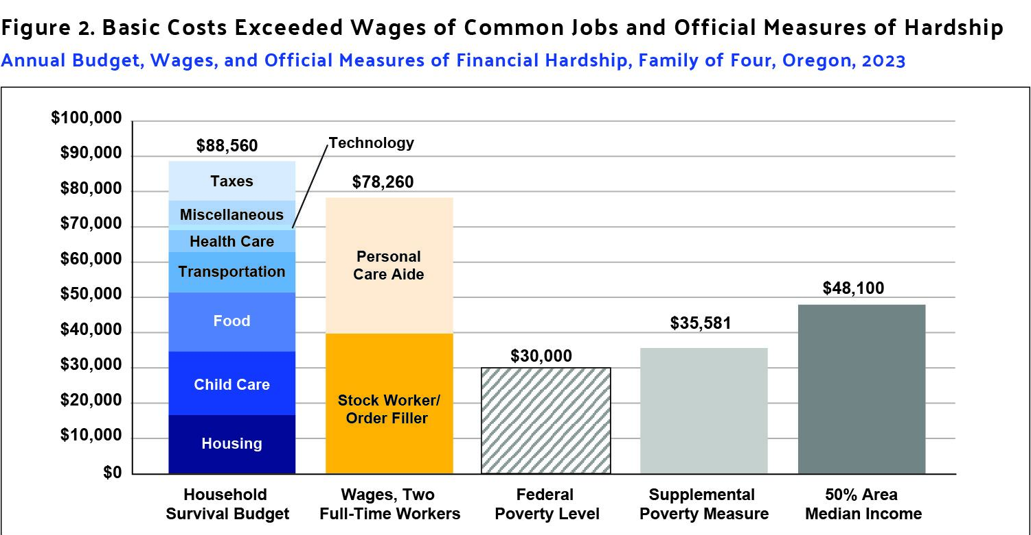
Oregon
When Paychecks Don’t Add Up
Data Source: United For ALICE® (2025). The State of ALICE in Oregon.
Notes:
So why is ALICE, ALICE? There are several factors that impact a household’s ability to afford basics, including systemic barriers in our communities that are keeping ALICE financially trapped, no matter how hard ALICE works. But the crux of the problem is the mismatch between the ever-increasing cost of expenses, and the wages that just aren’t keeping up. To understand this better, we need to look at the ALICE Household Survival Budget for families – that is, the minimum cost of housing, child care, food, transportation, health care, and technology, plus taxes. For a family of four in Oregon, the Household Survival Budget was $88,560 in 2023. But when we combine the full-time wages of two of the most common jobs in the state – a personal care aide and a stock worker/order filler – we see that this family, with both adults working, brought in $78,260 – more than $10,000 short of the cost of basics.
And when we factor in the Federal Poverty Level, which was $30,000, the dilemma facing countless ALICE families becomes clearer – when the Federal Poverty Level is used to determine eligibility for assistance programs such as SNAP, it’s no wonder there are so many families locked out of the supports that are so desperately needed.

Slide 10
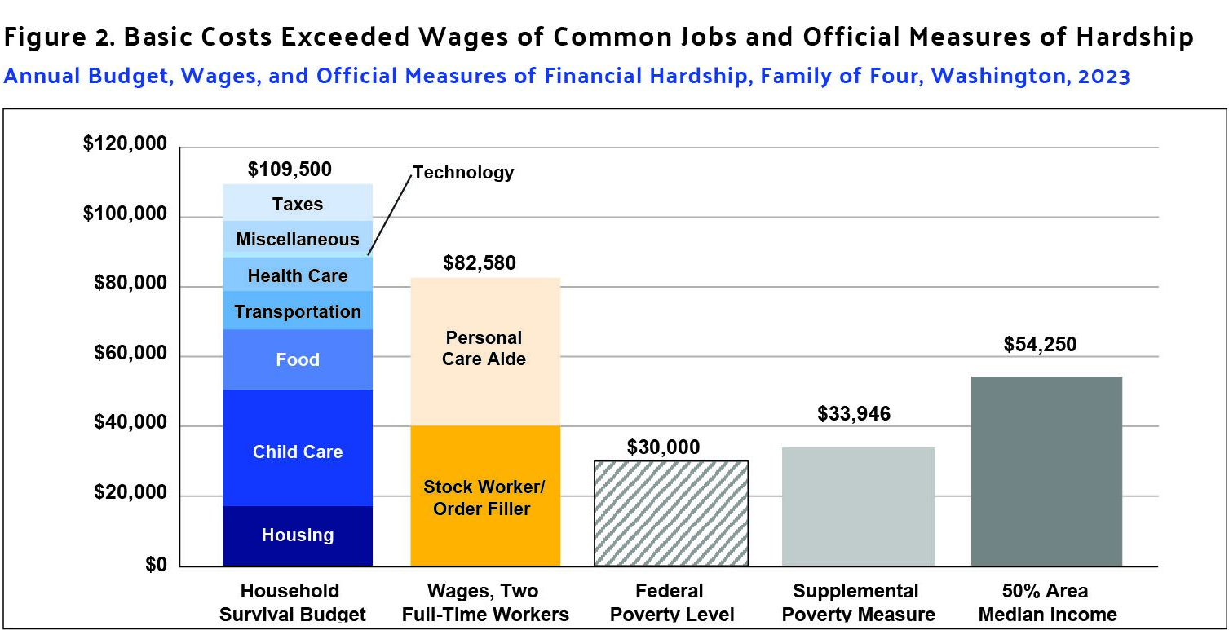
Washington
When Paychecks Don’t Add Up
Data Source: United For ALICE® (2025). The State of ALICE in Washington.
Notes:
And for a Washington family of four, the Household Survival Budget was $109,500 in 2023. But when we combine the full-time wages of two of the most common jobs in the state – a personal care aide and a stock worker/order filler – we see that this family, with both adults working, brought in $82,580 – nearly $27,000 short of the cost of basics.

Slide 11
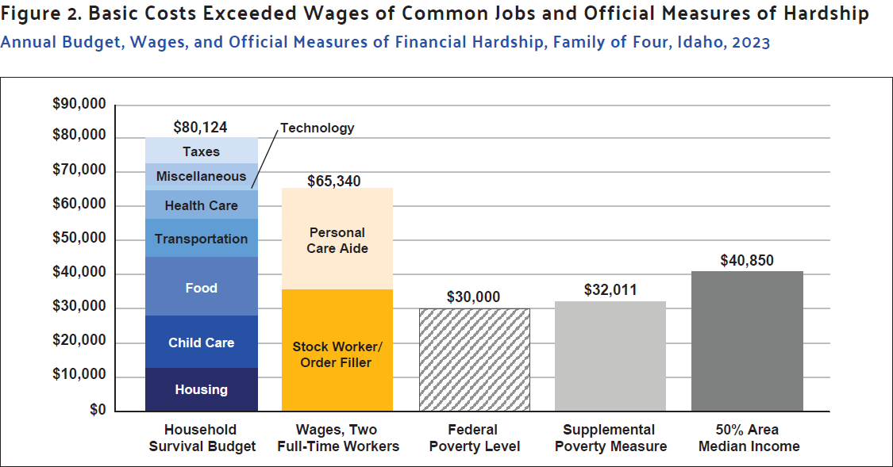
Idaho
When Paychecks Don’t Add Up
Data Source: United For ALICE® (2025). The State of ALICE in .
Notes:
And for a Washington family of four, the Household Survival Budget was $109,500 in 2023. But when we combine the full-time wages of two of the most common jobs in the state – a personal care aide and a stock worker/order filler – we see that this family, with both adults working, brought in $82,580 – nearly $27,000 short of the cost of basics.

Slide 12

Essential Workers, Insufficient Wages
Only 20.5%
of working-age people in OR, WA & ID had a full-time salaried job
34% of workers
in OR, WA, & ID’s 20 most common jobs couldn’t make ends meet
Notes:
Let’s dig a little deeper into how ALICE fits into the labor landscape in Oregon and Washington.
When we look specifically at the working-age population in both OR and WA, only 21.5% had a full-time job with a salary in 2023.
Zeroing in on working-age adults specifically in the labor force, 66% - were paid hourly and/or worked part time.
And if we look at the 20 most common jobs in OR, half paid less than $20 per hour in 2023 and in WA, only four of the most common jobs paid less than $20/hour.To put that in perspective, an hourly wage of $20 would equate to $40,000 annually if working full time. So it’s no surprise that of all the workers in these jobs, 33.5% struggled to make ends meet.

Slide 13
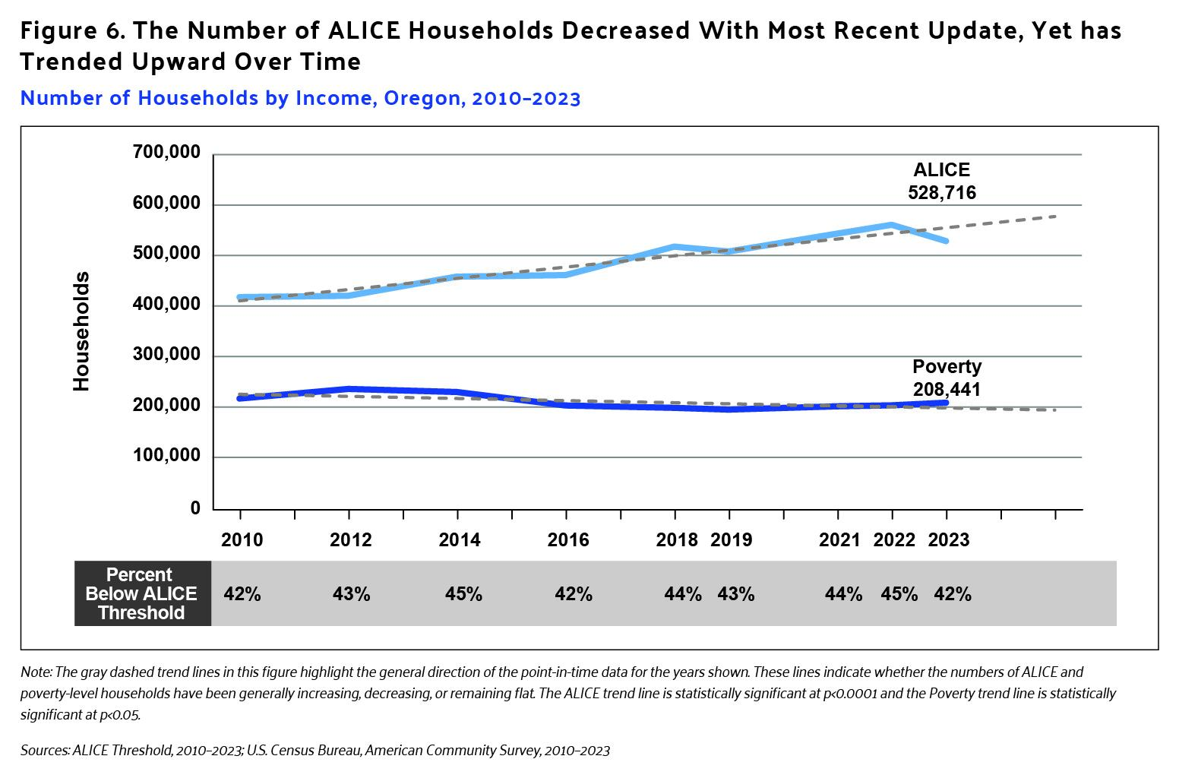
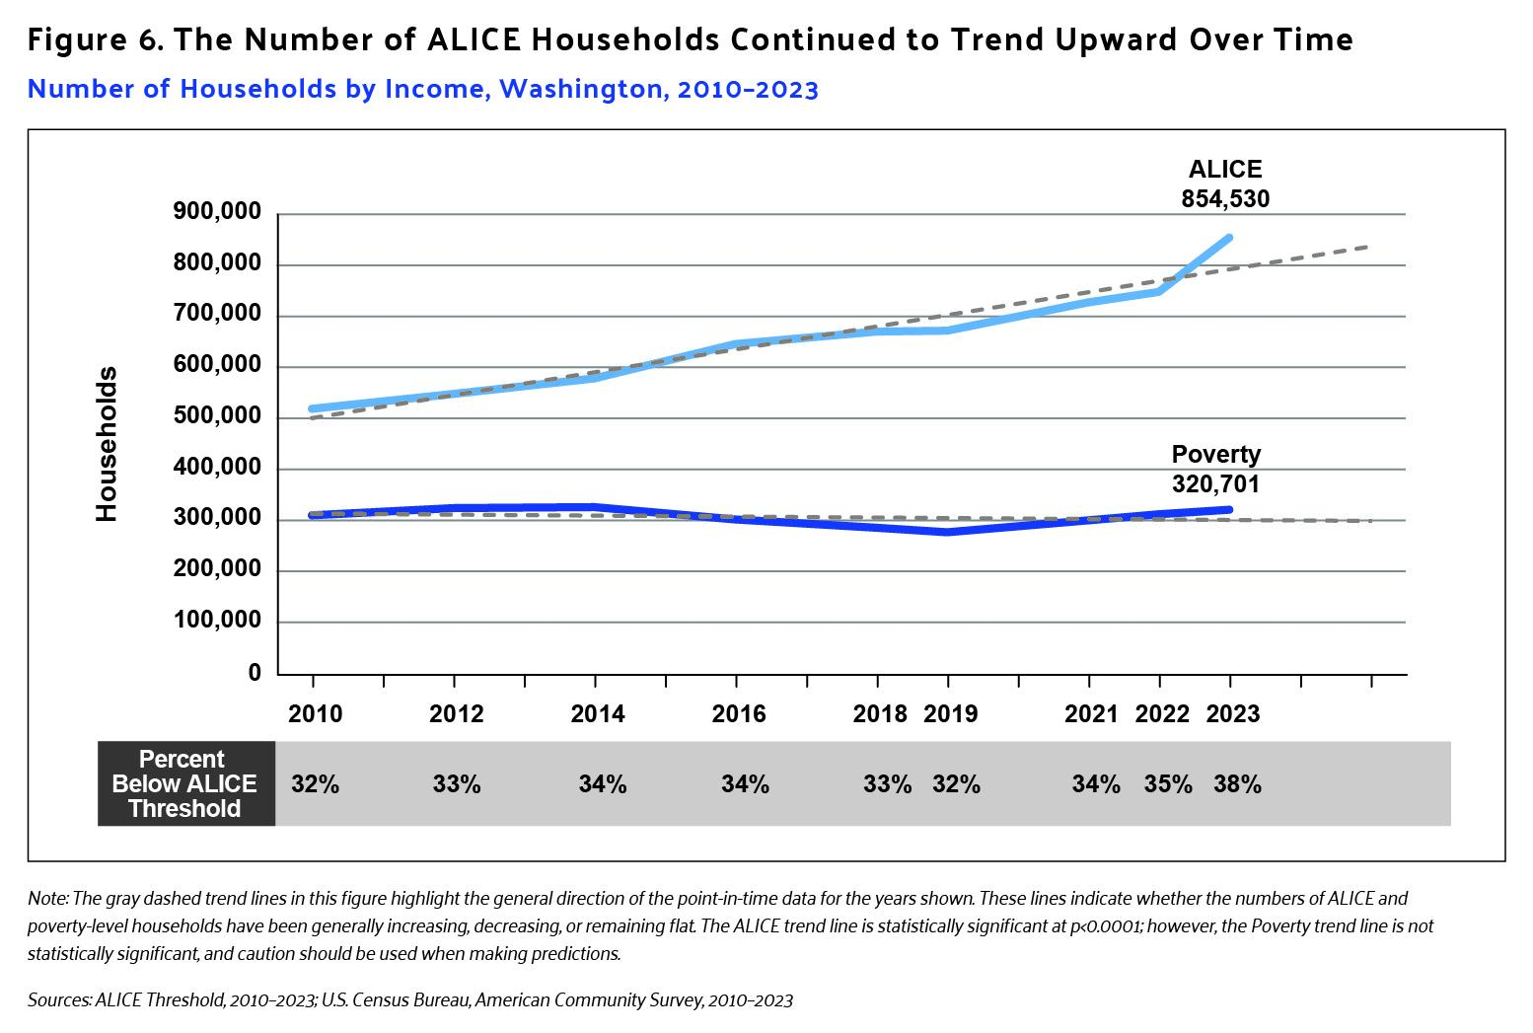
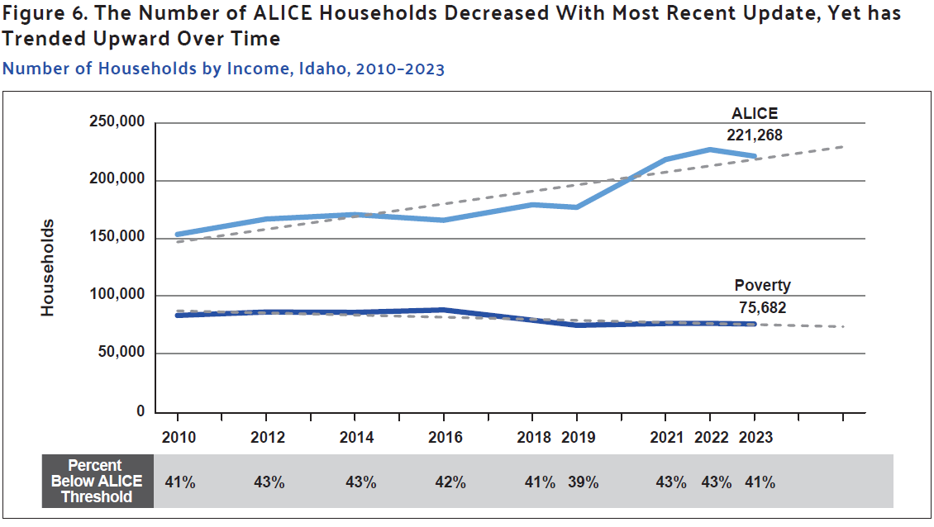
Financial Hardship Over Time
Oregon
Washington
Idaho
Notes:
When wages increase at a slower rate than basic expenses, purchasing power takes a hit. This is especially tough for ALICE households, who are already struggling to make ends meet without much assistance to cushion the blow.
How has this played out in the numbers? Over more than a decade, the total number of households in Oregon grew by 15%, and increased 19% in Washington.
During the same period, the number of households living in poverty in Oregon went down by 4%, and the number of ALICE households grew by 27%. For Washington, the number of households in poverty remained largely flat (increasing by 4%), and the number of ALICE households increased by 65%.

Slide 14

“
It definitely has been difficult. I have a lot of debt, you know, medical bills that we need to pay, so definitely every little bit helps.
“
Notes:
We’ve seen how ALICE numbers have evolved over time. But what does the future hold? The answer to that is in our hands. We have the power to alter the course for ALICE families, shaping our future for the better because when we lift up ALICE, we lift up entire communities.
This type of transformative impact takes an all-hands-on-deck approach. We all have a role to play – and there’s no role that’s too small. In the words of this ALICE mother, every little bit helps.

Slide 15
United for ALICE Website Tour
www.unitedforalice.org
Notes:
ALICE website walk through

Slide 16
UNITED IS THE WAY TO
HELP ALICE RISE.
Visit UnitedForALICE.org
Help amplify ALICE’s voice: ALICEvoices.org
Notes:
Together, let’s help build ALICE’s path to financial stability.
Visit UnitedForALICE.org to dig more into the data for the region. Use the research to drive change within your sphere of influence, and share your findings with your peers to build awareness and spark change in even larger circles.
And if you know of an ALICE worker or family who would be willing to share their experiences and help amplify ALICE's voice, please encourage them to submit an audio recording at ALICEvoices.org.

Slide 17
Breakout Discussion:
How can ALICE data be used in work both professional and volunteer?
What OnPoint Community Credit Union products are relevant and approachable for ALICE families?

Slide 18
Thank You!
Questions?

